Slide 1


Global Economy Analysis
Comparative Study of the World's 10 Largest Economies (2021)
by Nicolae-Valetin Radu

Slide 2

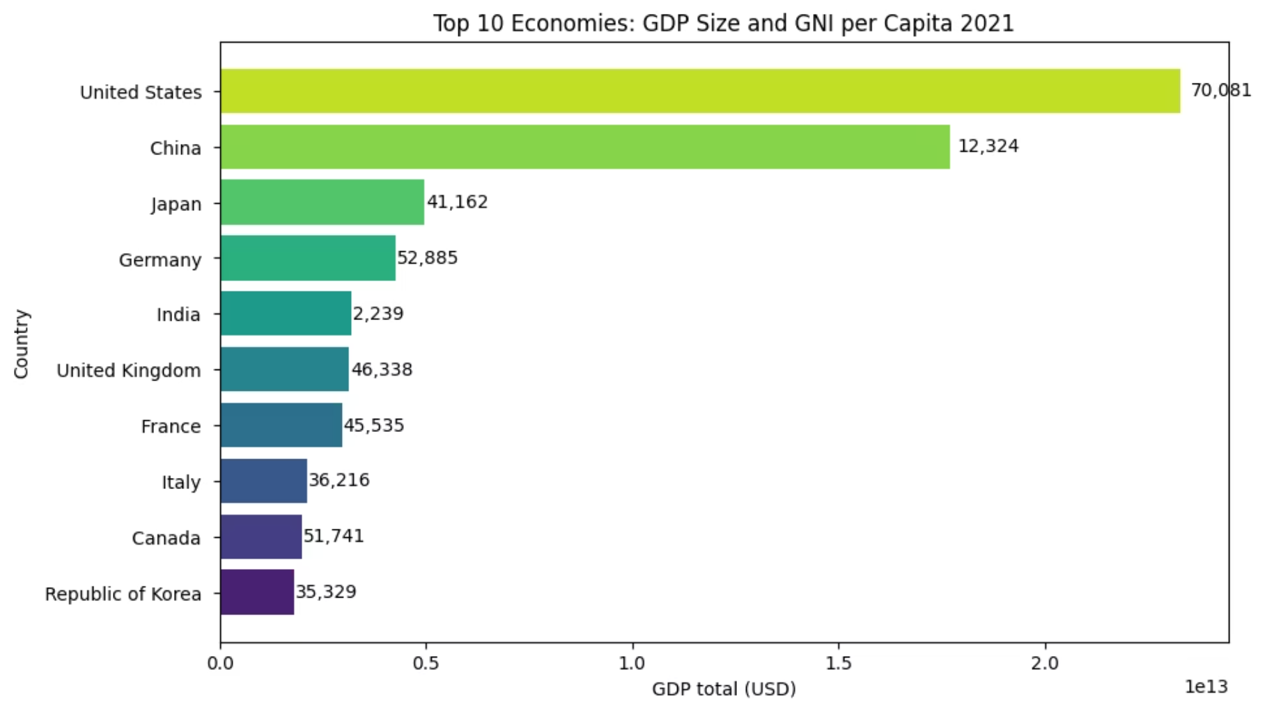
GDP Overview: Economic Powerhouses
The comparative analysis between total GDP and GNI per capita reveals a profound gap between the macroeconomic power of a state and the actual prosperity of its citizens, proving that a massive economy does not automatically translate into a high standard of living for everyone. While the United States successfully transforms its global leadership into a top-tier per capita income, China presents a more complex picture; although it has regions that are highly developed where people enjoy a very good life, the country's massive population and the existence of vast underdeveloped sectors pull the national average down to 12,324 USD. Similarly, India possesses significant national economic weight, but its standard of living remains at 2,239 USD per capita, reflecting the ongoing struggle to bridge the gap between its growing urban centers and its rural areas. Ultimately, these figures show that being an economic superpower is one thing, but ensuring individual wealth across such a huge population while managing both highly advanced and underdeveloped regions is a completely different challenge.
by Nicolae-Valetin Radu

Slide 3

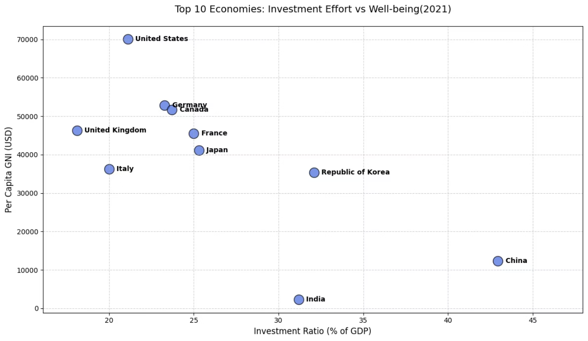
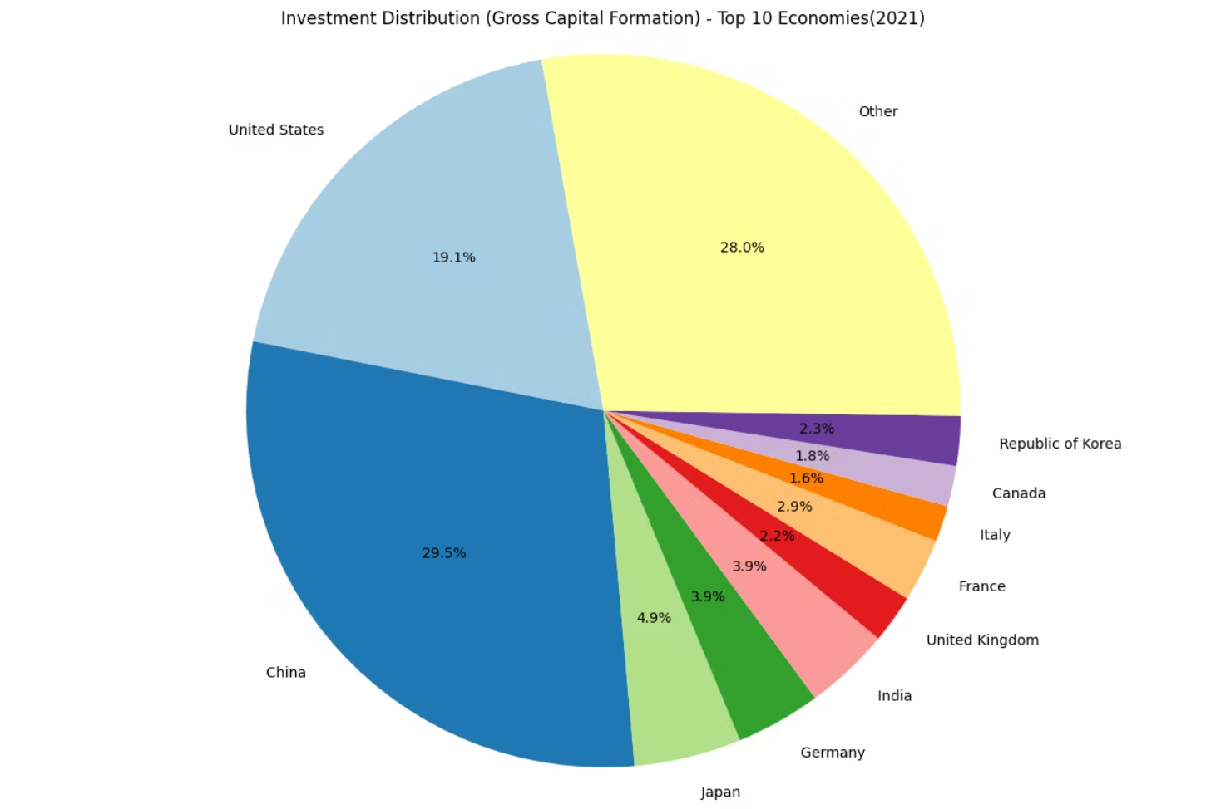
Investment Distribution
In 2021, the global economic landscape was heavily affected by the pandemic, and data shows that China used this context to consolidate its position as an industrial leader. With a record investment effort of 43% of GDP, China directed massive resources not only to general infrastructure, but also to critical sectors relevant to managing the COVID-19 crisis, such as the medical industry, bio-technology and export logistics. This strategy allowed China to hold a 29.5% share of the total investment of the top 10 world economies, becoming the main global supplier of equipment and essential goods while other nations faced production bottlenecks. Thus, while economies such as the US or Germany maintained moderate investment rates (21-23% of GDP), China accelerated its modernization of underdeveloped sectors and took advantage of the global pandemic demand to finance its long-term economic growth.
by Nicolae-Valetin Radu

Slide 4
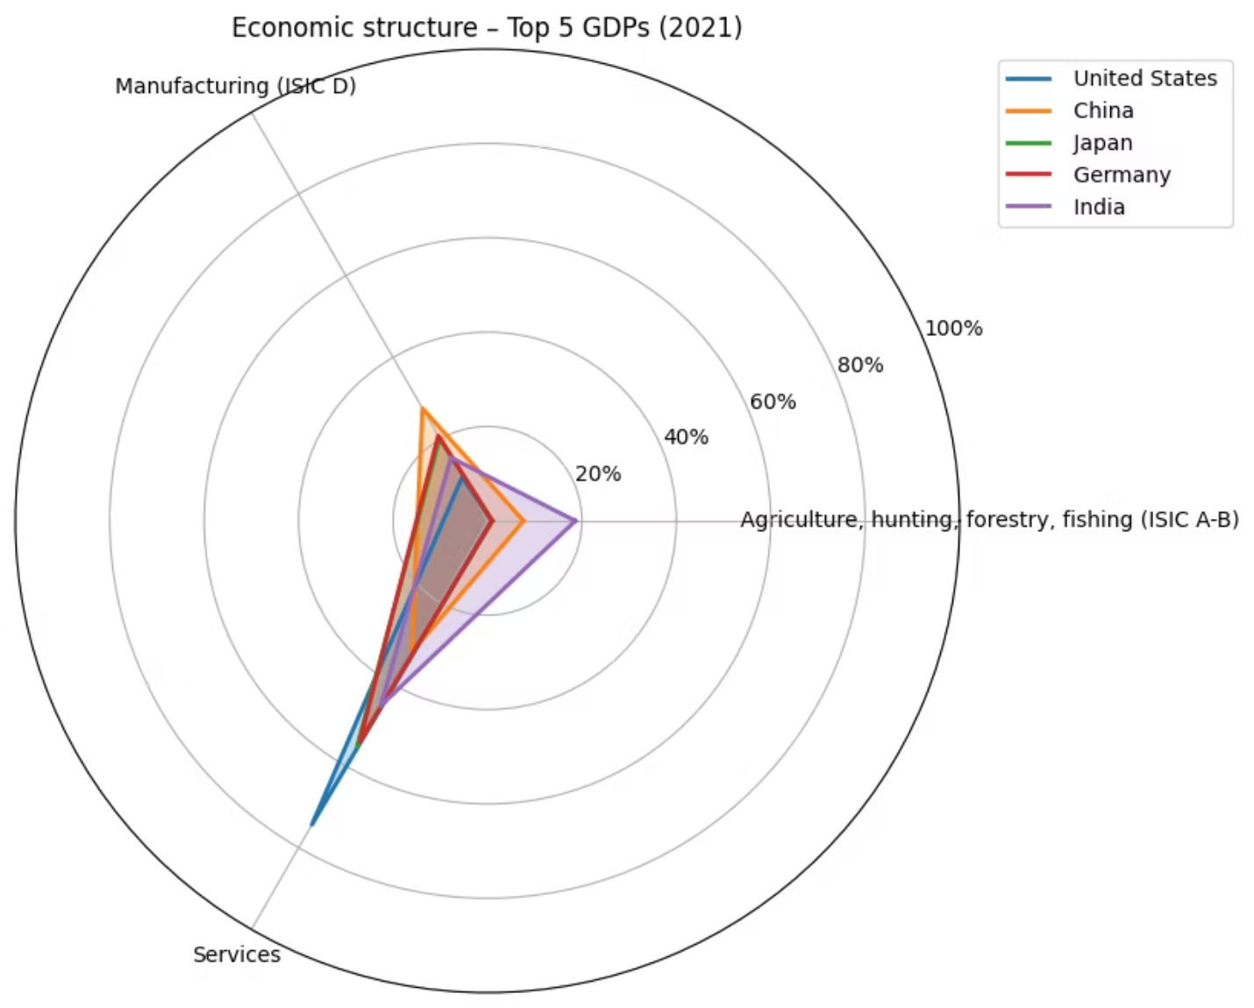
Configuration of Economic Sectors: Growth Patterns in the Top 5 GDP
The sectoral structure of the world's five largest economies in 2021 highlights contrasting development patterns, with the United States and Japan defining themselves as post-industrial powers heavily dominated by the service sector, while China and Germany retain their identity as the "workshops of the world" through high shares in industrial production. This structural footprint explains the different resilience to pandemic shocks, with India being the only major power to retain a significant agricultural component, while Western economies have managed to convert their technological advance and services into high value added. In the context of 2021, the radar chart demonstrates that sectoral specialization dictates each nation's role in the global value chain, forcing industrial economies to invest heavily in infrastructure to support production, while service-based economies prioritize domestic consumption efficiency and financial stability.
by Nicolae-Valetin Radu

Slide 5
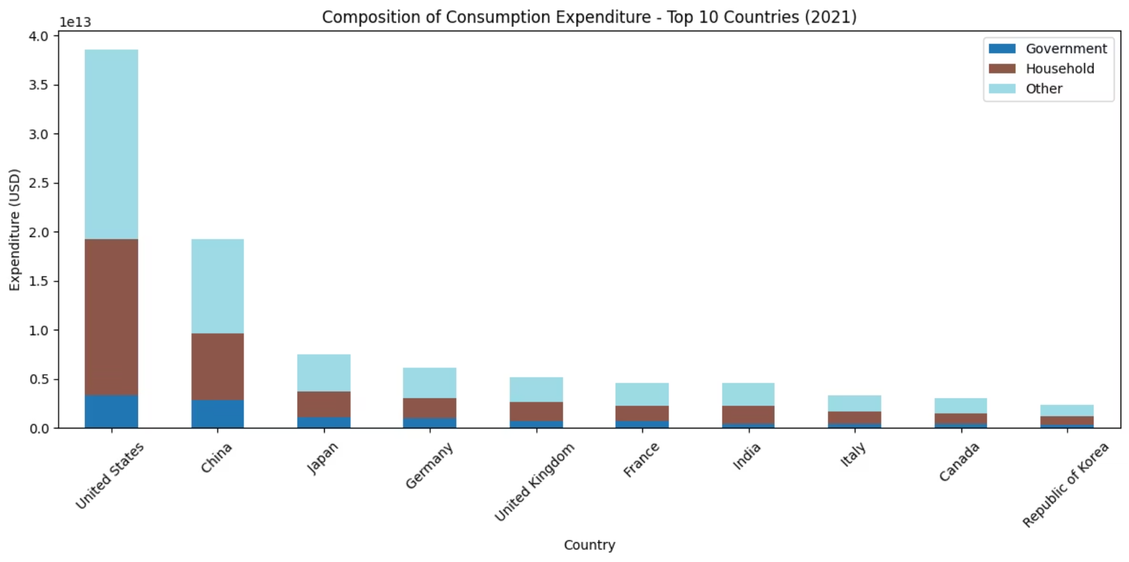
Composition Of Consumption Expediture
The United States is the undisputed leader, with total spending exceeding USD 38 trillion, supported massively by household consumption. In contrast, China ranks second with approximately USD 19 trillion, but it is remarkable that, in the context of the pandemic, Chinese government spending is very close to that of the United States (almost USD 3 trillion each), reflecting the state's intervention in managing the crisis and supporting the economy. While mature economies such as Japan and Germany show stable consumption, but much lower in absolute volume, India and other emerging powers allocate significant weights to state consumption compared to private consumption, highlighting the authorities' effort to stimulate domestic demand in a year marked by health and economic uncertainty.
by Nicolae-Valetin Radu

Slide 6
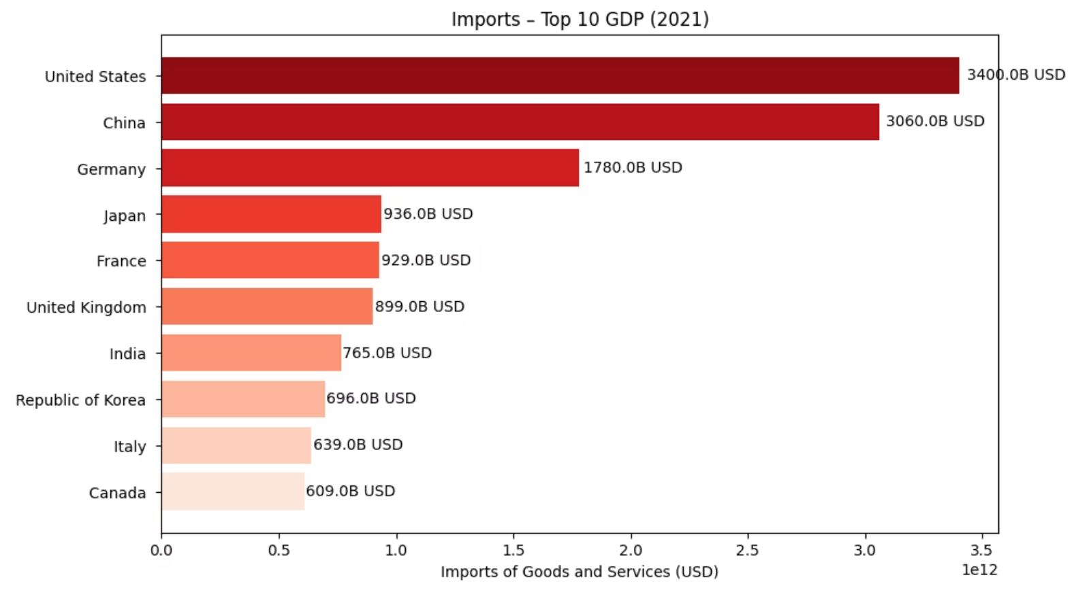
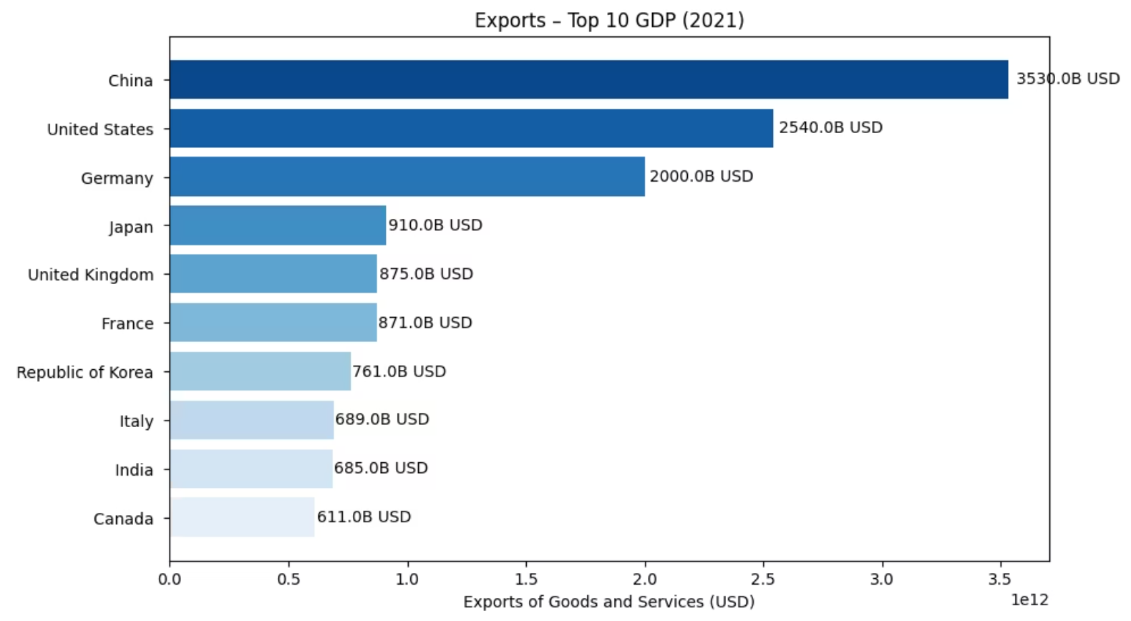
Global Trade Balance
The analysis of trade flows highlights divergent roles in the global economy, with China consolidating itself as the absolute leader in exports, reaching a record value of over 3,530 billion USD, followed by the United States and Germany. While the United States holds the position of the largest global importer ($3,400 billion), generating a massive trade deficit that fuels domestic consumption, economies such as China and Germany manage to maintain sizeable trade surpluses, confirming their status as strategic suppliers of industrial goods. This structural imbalance, accentuated during the pandemic by the huge demand for manufactured goods, underlines the dependence of service-based economies on the production capacity of the Eurasian bloc, transforming the trade balance into a critical indicator of resilience and economic influence on the international stage.
by Nicolae-Valetin Radu

Slide 7
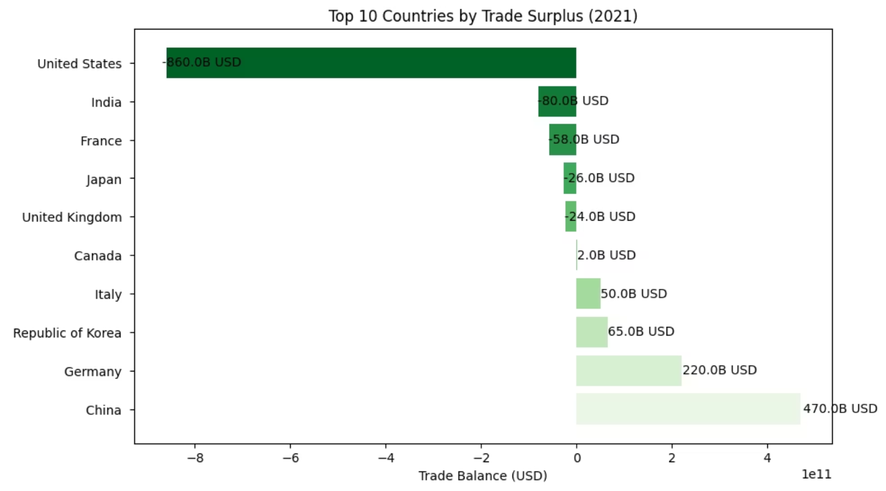
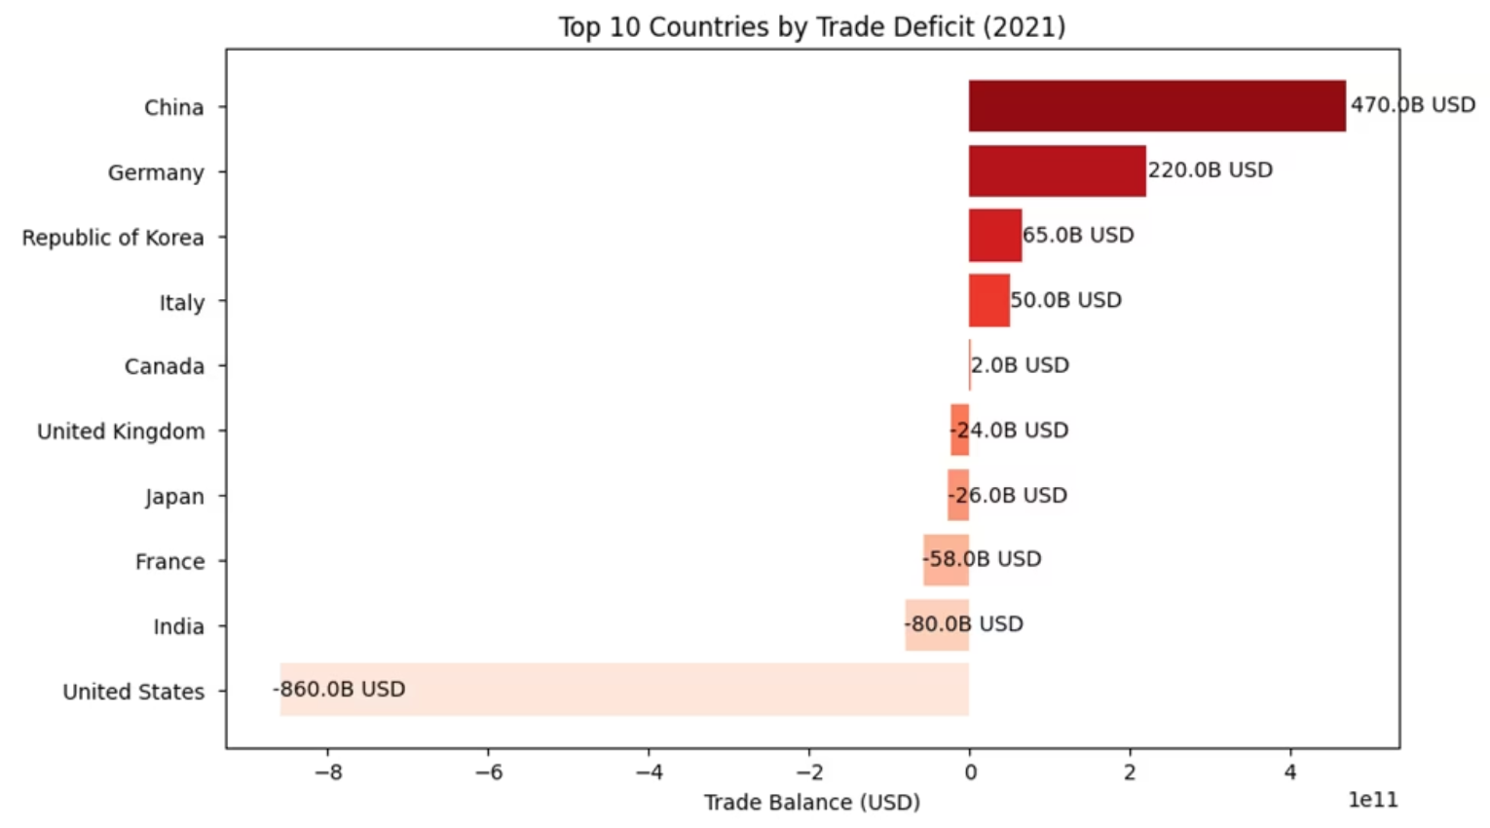
Trade Balance: Export vs Import Dynamics
Here we can see China consolidating its position as the absolute leader in exports with a record value of $3.53 trillion, taking advantage of its status as the only major manufacturing hub that remained fully operational during the critical phases of the pandemic. While the United States acted as a consumer engine, generating a massive trade deficit of $860 billion through imports of $3.4 trillion, China accelerated its economic growth by capturing global demand for manufactured goods and medical equipment, achieving a record trade surplus of $470 billion. This strategic advance in 2021 demonstrates how China has used the pandemic context to increase its global market share and finance its domestic development, transforming the health crisis into a catalyst for consolidating its commercial power against Western competitors.
by Nicolae-Valetin Radu

Slide 8
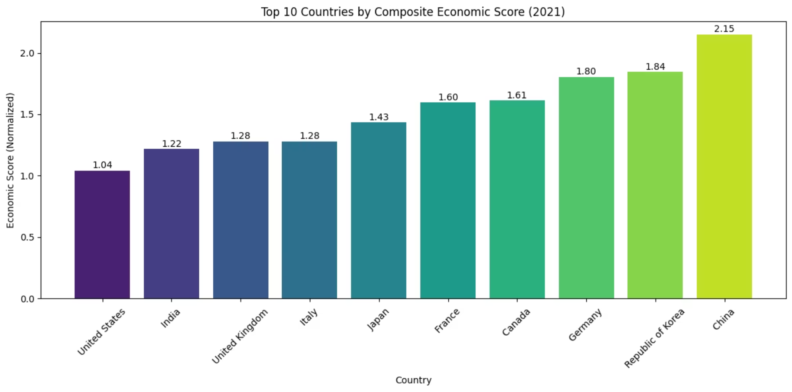
Economic Performance Hierarchy: 2021 Composite Ranking
The Composite Economic Score highlights that macroeconomic dominance is not dictated solely by the size of GDP, but by a nation’s ability to balance investment, production, and trade. China ranks first with a score of 2.15, demonstrating how using the pandemic context to generate massive trade surpluses ($470 billion) and maintaining a record investment rate of over 40% of GDP created an unparalleled growth engine that year. At the other extreme, the United States scores the lowest (1.04) in this elite group, as its economic model is based on huge domestic consumption and a record trade deficit ($860 billion), which, in this calculation model, indicates a mature economy but less oriented towards gross capital accumulation compared to emerging powers. Thus, the final ranking confirms that 2021 favored the "workshops of the world" and economies with solid trade surpluses, such as the Republic of Korea and Germany, to the detriment of traditional consumer hubs.
by Nicolae-Valetin Radu

Slide 9
Insights:
The competition for global leadership between the United States and China highlights two distinct economic philosophies. On one hand, the United States prioritizes domestic economic activity and individual prosperity. By relying heavily on a service-based economy and strong domestic consumption, it maintains a high standard of living, with a GNI per capita of approximately $70,000. Although its investment rate is relatively modest at around 21% of GDP, the sheer scale of the U.S. economy still makes it the world’s second-largest investor, accounting for 19.1% of global capital formation. However, the United States also records a significant trade deficit of $860 billion, reflecting a strong dependence on imported manufactured goods.
Meanwhile, China has adopted a long-term development strategy that prioritizes economic expansion over living standards. In that way, it has approximately 43% of GDP reinvested domestically, reflecting a growth-oriented investment model. This approach has positioned China as the world’s largest investor, accounting for 29.5% of global capital formation, and reinforced its role as a key global supplier, particularly during the COVID-19 pandemic, when exports of medical goods generated a trade surplus of around $470 billion. Despite this scale and performance, China’s average GNI per capita remains relatively low at $12,324. This outcome is largely explained by the country’s large population and pronounced regional disparities, where highly developed urban centers coexist with less developed rural and interior regions. Overall, China’s economic model is designed to support long-term structural growth rather than immediate gains in individual prosperity.
Beyond the two dominant powers, other large economies take a more balanced approach. Germany, South Korea and others serve as prime examples of efficiency-driven growth, where high living standards are paired with robust trade surpluses, specialized in manufacturing sectors. These nations are more focused on sustaining their economies at the top level, but relying more on partnerships with the two titans, while still investing and innovating across different sectors. India, meanwhile, is approaching a more aggressive method that echoes China’s earlier development stages, focusing on investment with an economy oriented toward services and agriculture, while living standards are low.
by Nicolae-Valetin Radu

Slide 10



Tools and resources:
Technologies used:
Repositories / Data Sources:
Python - programming language for data analysis and visualization
Kaggle - Glabal Economy Indicators
Pandas - data cleaning, manipulation, and analysis
Matplotlib - plotting and basic data visualization
Seaborn - advanced statistical visualizations and charts
SQLite - in-memory database for querying and organizing data
Google Colab - interactive coding and presentation environment
gamma.app - presentation environment
Github - Project repository for the analysis of global economic indicators
by Nicolae-Valetin Radu

Slide 11

Disclaimer
This project is intended for educational purposes and to demonstrate my data analysis skills. It showcases relevant analytical methods, visualizations, and interpretations to explore the complexity of major global economies. While the dataset is publicly available, its accuracy is not guaranteed; some data may be illustrative, partially representative, or simplified for analysis. The focus of this work is on methodology, insights, and the demonstration of analytical capabilities rather than on the absolute correctness of the underlying data.
Visual Sources:
AI-generated images | Python-generated charts (Pandas, Matplotlib, Seaborn) | Pixabay: https://pixabay.com
by Nicolae-Valetin Radu

